Slide 1
Parallel SQL execution (aka PX) & relevance to Data warehousing & Mining
Oracle, for more than 25 years (along with 2 or 3 other major DB vendors)
has a long history of parallel SQL capability
Originally called parallel query option (PQO),
+ Advantage: generates results more quickly than serial execution
- Disadvantage: requires large resource usage
PQO has developed/extended, now known as parallel execution (PX)
Interestingly, PX might be used in many places:
- parallel DML { multi-row INSERT/UPDATE }
- parallel DDL { creating tables, indexes, views, etc. }
- parallel direct-loading { of external data files into tables }
- parallel cloning { of schemas/databases, etc }
- parallel recovery { Undo, Redo, partial/full backups & restores }
Ways to physically parallelize
Use hardware in parallel (Examples: CPUs, disk such as RAID, connection topology)
Ways to logically parallelize
- Concurrent scans/sorts/ aggregates/ etc. using Oracle-allocated processes
The basic technique – parallelize using 1 server & lots of CPUs, not
several “loosely-networked” servers
Limited hardware at CSUS => in CSC174: 1 server, n CPUs, (non-RAID) disks

Slide 2
PX relevance to Data warehousing & Mining
SQL has many opportunities for PX
a) ORDER BY / GROUP BY / aggregates / etc
b) table scan => scan sections of a table independently
c) Processing partitioned objects (such as tables / indexes)
=> division of a table into m partitions with disjoint data
(more on partitions soon – fundamental to large RDBMS & DW)
Transparency with optional user influence
> SQL parallelism is transparent – you do not need to ‘program’ it
> However, you can add SQL “hint” clauses to a SQL statement to
influence/affect QEPs generated by query optimizer (q0)
Extending Oracle SQL syntax with PX “hints”:
SQL verb (SELECT/UPDATE/…) /*+ hint directive(s) */ Rest_of_SQL_Statement;
Ex: SELECT /*+ NO_INDEX(sales pk_sales) */ col … FROM sales, cust WHERE …
The hint means: do NOT use specified table index when processing SQL stmt
Hint syntax: (can contain >=1 hint directive, each separated by >=1 blank character)
You can – Use default PX or specify PX level vs.
- Prohibit parallelism

Slide 3
Basic example of parallelizing an SQL statement
S = select /*= hints */ * from T order by C;
Note: Execution forces a scan of T
Assume T is parameterized (i.e. “configured”) for PX to use <= 8 PXs
The (simplified) PX execution model:
One PX, called QC coordinates 2 forms of parallelism:
inter-PX
S → 4 sub-scans of T As soon as Producer 4 sub-sorts & merge
using 4 PXs → gets data, it starts feed → of data from
to sorting Producer
{Producer} {Consumer}
intra-PX intra-PX

Slide 4
(Some of the) database operations that can be parallelized
Example operations that can utilize parallelism
Query (ie SELECT)
DML
create table AS select …
create materialized view
data load
index re-build
statistics gathering for qo
etc
Table Parameters expanded:
> Tablespace (new or existing or default, if not named) - a tablespace object specifies storage parameters for how table row storage is physically allocated and how growth space is managed (Note: every table has an associated tablespace)
> Parallel n – max. number of PX slaves to allocate for SQL processing
> Nologging: do not log 1) table CTAS or 2) subsequent table DML transactions
CREATE TABLE f_monthly_acctg_stage
TABLESPACE stage
PARALLEL 8
NOLOGGING
AS
SELECT /*+ PARALLEL(f,8) */
period_id,
store_id,
location_id,
account_id,
SUM(acctg_nmbr) acctg_nmbr
FROM f_daily_acctg f
GROUP BY
period_id,
store_id,
location_id,
account_id;
Table Parameters for table storage
Parallelized query for accessing the data to populate new table

Slide 5
PX relevance to Data warehousing & Mining
As we know, qo considers PX as it generates “query execution plans QEPj
For an SQL engine, such as Oracle/DB2/ (and unlike mySQL)
processing an SQL statement “S” involves
the additional step of qo
A given QEPj might or might not specify PX
Whether a particular QEPj for statement S uses PX depends on:
a) clauses (group by, order by, …) and structure (nesting, etc.) of S
b) Availability and Accuracy of DD stats, such as table column
value distributions, index type, etc
c) Default values when stats are not available
d) Hints specified (if any)
e) Resources – Example: if PX parameters specify we want 20 parallel processes, but current available resources can only allocate 10,
then the default is to proceed with 10 (instead of aborting)
f) Other factors

Slide 6
The origins of parallelizing SQL
Parallel SQL was originally intended for 1 user in DW to consume 100% of machine resources for tuning one monster SQL operation. This allowed feasible solutions to DW running in minutes/hours, instead of days
Parallel SQL is NOT scalable across one DB instance, because
Each PX statement will try to acquire as much of the available machine resources as possible because PX algorithms are greedy
=> each of n PX users gets <= 1/n of total resources
Practical consequence of the above:
most production tp mode statements do not need PX
if “big” PX is known to significantly speed up an operation O, then schedule O to run during off-hours
=> DB workload should be planned & deployed carefully
➔ ➔ You cannot optimize everything for every user 100% of the time

Slide 7
No PX vs. PX on “small SQL”
The ineffectiveness of PX on small problems
Ex 1: SELECT degree from user_tables where table_name = ‘CUSTOMERS’;
DEGREE
1
SELECT count(*) from CUSTOMERS;
COUNT(*)
984
Elapsed: 00:00:00.09
Ex 2: ALTER TABLE CUSTOMERS PARALLEL(DEGREE 4);
SELECT degree from user_tables where table_name = ‘CUSTOMERS’;
DEGREE
4
SELECT count(*) from CUSTOMERS;
COUNT(*)
984
Elapsed: 00:00:00.18
Parallelism actually ran twice as slow as serial execution!!!
=> The overhead of parallelism is not justified for small queries
The table is small and is not accessed in parallel because a) it is NOT a big SQL query and b) table degree is 1
Typical of small SQL, forcing parallelism is actually the worst thing to do!

Slide 8
PX and other techniques for Very Large DBs & DW
Next few slides illustrate: Common uses of PX & other techniques for “big SQL”
Tables are stable vs. volatile content of indexes =>
* building/refreshing indexes & stats collection usually faster with PX
* The SQL qo relies on up-to-date statistics to generate better QEPs
HandOut & Discuss: PXs_vs_noPX_SH_cartProd.out
Demos examples of PX for faster processing
=> Remember: 4 CPUs are the only non-basic hardware capability for PX used
---------------------------------------------------------------------------------------------------------------------
Better hardware and partitioned tables & indexes would enable:
1. ability to administer partitions independently of each other (+: DBA)
2. parallelize I/O with RAID disk storage (+ PX’s I/O physically parallelized)
“Logical” Partitioning a table - Example
CREATE TABLE invoices
(invoice_no NUMBER NOT NULL,
invoice_date DATE NOT NULL, Can specify different disk controllers
comments VARCHAR2(500)) for physical parallelized I/O
PARTITION BY RANGE (invoice_date)
(PARTITION invoices_q1 VALUES LESS THAN (TO_DATE('01/04/2001', 'DD/MM/YYYY')) TABLESPACE users, PARTITION invoices_q2 VALUES LESS THAN (TO_DATE('01/07/2001', 'DD/MM/YYYY')) TABLESPACE users, PARTITION invoices_q3 VALUES LESS THAN (TO_DATE('01/09/2001', 'DD/MM/YYYY')) TABLESPACE users, PARTITION invoices_q4 VALUES LESS THAN (TO_DATE('01/01/2002', 'DD/MM/YYYY')) TABLESPACE users);
The CREATE command specifies conceptually (by data range values) the basis for partitioning table invoices;
Each invoices_qj is an independent SQL-processible table (See 3 slides ahead)

Slide 9
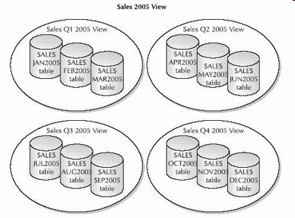
Physical data partitioning – the original ‘logical’ partitioning way
The original physical DB design technique for “partitioning” was to create tables with different names, but identical schemas. Each quarter’s data is a UNION of 3 monthly views, and all data is the UNION of the quarterly views. Disadvantages include: view maintenance, inefficient joins, and no easy way to reference an arbitrary subset of the tables

Slide 10
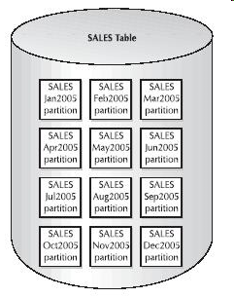
Partition object ‘physical’ partitioning – the new way
Advantages of partition objects include
The size of each underlying data file (where a partition is stored) is generally smaller for each partitioned tables than non-partitioned tables => More data-focused backups.
Historical partitions can be made read-only and will not need to be backed up more than once => Reduces backup overhead
The structure of a partitioned table needs to be defined only once. New subsets of data are assigned to the correct partition, based on the partition option chosen.
Individual tablespaces and/or their data files can be taken offline for maintenance or archiving without affecting other subsets. (alter table abc drop partition xyz removes a partition)

Slide 11
Oracle DD info about table partitions
The Oracle DD is “aware” (i.e. contains DD info about) of partitions of various kinds:
Table
Index
etc
Example query on the SH schema, and some fragments of the results
SQL> column object_name format a30
SQL> select object_name, subobject_name from user_objects
2 where object_type = 'TABLE PARTITION'
3 order by object_name;
OBJECT_NAME SUBOBJECT_NAME
------------------------------ ------------------------------
COSTS COSTS_Q3_2002
COSTS COSTS_Q2_2002
:
SALES SALES_Q4_2003
SALES SALES_1995
SALES SALES_H1_1997
:
Tables sales and costs are partitioned;
Table sales has a huge number of rows (& continually growing),

Slide 12
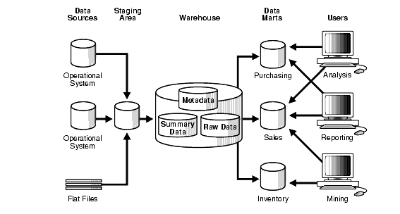
DW/Mining – functional environment

Slide 13
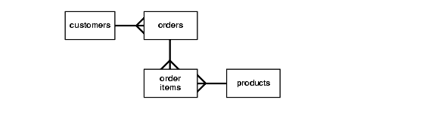
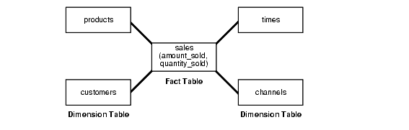
DW schema alternatives – Overview
Various schema structures can be used in DW – some examples
Figure - 3NF_Schema
Customary normalized tables as in tp mode databases
Figure - Star schema

Slide 14
Star schema basics
The SH schema is installed, by default, when an Oracle instance is generated
The SH schema is a simple Demo of the basics of a Star-schema based DW
(a Star schema is NOT a natural/expected extension of ER, nor EER modeling)
A typical Star schema consists of
>= 1 “fact table" (Example: sales)
Each fact table has FKs referencing m "dimension tables“ (Example: customers)
A dimension table contains more detail about an FK column
(that is property) in a given fact table row
Fact table
One of the characteristics of Star is that queries Q often involve joining a fact
table with several dimension tables
This is where the query optimizer (qo) is
invaluable with its ability to evaluate relative costs of the (possibly thousands)
different orders in which m table joins can be done
(Note: there an be more than 1 "hub", aka fact table, in a Star schema)

Slide 15
Star schema querying
An example of a Star query on the SH schema
(Working with such queries, and how to make them run fast enough for a realistic DW is covered in detail in CSc 176 – Spr 2012)
SELECT ch.channel_class, c.cust_city, t.calendar_quarter_desc, SUM(s.amount_sold) sales_amount
FROM sales s, times t, customers c, channels ch
WHERE s.time_id = t.time_id AND
s.cust_id = c.cust_id AND
s.channel_id = ch.channel_id AND
c.cust_state_province = 'CA‘ AND
ch.channel_desc in ('Internet','Catalog') AND ← Sales channel description t.calendar_quarter_desc IN ('1999-Q1','1999-Q2') ← Time partitions
GROUP BY ch.channel_class, c.cust_city, t.calendar_quarter_desc;
Typical QEPs for this kind of query are complex (can be pages long !)
because
Various transforms of query would be applied
other advanced AMs we have not covered in CSc 174 would be used

